Slide 1

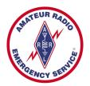
Training Volunteers
The ARRL
Introduction to Emergency Communication Course
EC-001 (2011)
Session Four
Notes:
Make sure you have modified the Name and Date.
Display this screen as students are arriving for class.

Slide 2
Reminder
Complete two DHS/FEMA Courses
IS-100.b Introduction to ICS
IS-700 National Incident Management System
Http://training.fema.gov/IS/NIMS.asp
Notes:
ARRL conditions!
The two ICS courses must be complete before taking the final exam.

Slide 3
Session Four Topic
Session 1 – Topics 1, 2, 3, 4, 5a, 5b
Session 2 – Topics 6, 7a, 7b, 7c, 7d, 8, 9, 10
Session 3 – Topics 11, 12, 13, 14, 15
Session 4 – Topics 16, 17, 18, 19, 20
Session 5 – Topics 21, 22, 23, 24, 25, 26, 27
Session 6 – Topics 28, 29, Summary, Final Exam
Notes:
The course requires a total of 18 hours.
If a student misses one class they can take a practice quiz for each lesson missed.
A student missing two sessions will be asked to take the course again.
A student missing the last session must wait for the next class and attend the final session for taking the exam again.
An exception would be two Field Examiners agreeing to give the exam at a mutually scheduled time.

Slide 4
Topic 18 – Equipment Choices for Emergency Communication

Slide 5
There is no one "best" set of equipment that will
ensure success for every assignment

Slide 6
January 1, 2013
“When Deployed” for PS or emergencies
Expected outer garment
Standardized look for ARES
Easily Recognized
ID Requirements of NIMS
Waivers granted by SEC

Slide 7
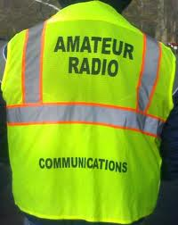
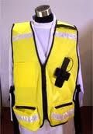
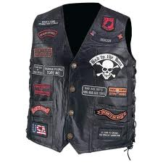
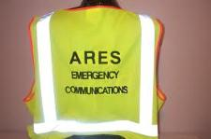
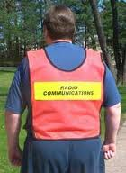

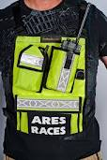
Professionalism

Slide 8
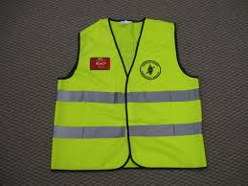
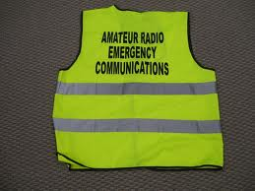
Standardized Outer Garment
Safety Green (yellow)
Sliver Reflective Tape
Black Letters on back & black LOGO
ID Badge
Can add organizational name on back in 1” letters or front in ½” letters under the LOGO

Slide 9
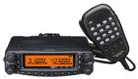
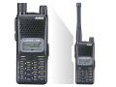
Transceivers - VHF/UHF
Dual band (2m, 440MHz) FM mobile transceiver
35-50 watt
Rugged and reliable
Can operate at reasonably high duty cycles
An external cooling fan if one is not built-in
Handheld transceivers used only when:
Extreme portability is needed
"shadowing" an official
Adequate battery or other DC power is not available
Should not be relied upon to operate with a high duty-cycle at maximum power
They can overheat and fail
Notes:
some models allow simultaneous reception on more than one frequency on the same band
Some mobiles have separate external speaker outputs for each band. For high traffic locations, such as a Net Control or Emergency Operations Center, a separate radio for each net is a better choice since it allows both to be used simultaneously by different operators. (Antennas must be adequately separated to avoid "de-sensing.")
Many dual-band transceivers also offer a "cross-band repeater" function, useful for linking local portables with distant repeaters, or as a quickly deployable hill-top repeater. True repeater operation is only possible if all other mobile and portable stations have true dual-band radios. Some so-called "dual" or "twin" band radios do not allow simultaneous or cross-band operation -- read the specifications carefully before you purchase one.

Slide 10
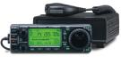
Transceivers - HF
Having both AC and DC power capability
12 Volt HF radios
100 watt
QRP (less than 5 watts)
100 watt variable output radios should be used
Unless power consumption is extremely important
Overcome noise at the receiving station by using high power
Turn it down to conserve battery power when necessary
Do not use DC to AC inverters to power HF radios
Notes:
Most use a high-frequency conversion process that generates significant broad-spectrum RF noise at HF frequencies that is difficult to suppress. Direct DC powering is more efficient in any case.

Slide 11
Voltage Tolerance
12 Volts DC
13.0 to 13.8 Volts DC
11.5 to 15 Volts DC
Transmit vs. Receive

Slide 12
Radio Receiver Performance
Sensitivity
Ability to receive weak signals
Selectivity
Ability to reject signals on adjacent frequencies
Intermodulation rejection
Ability to prevent undesired signals from mixing within the receiver and causing interference
Important when operating near public service and business radio transmitters

Slide 13
Radio Receiver Performance (cont)
Receiver filters
Important for effective HF operation.
Choose appropriate filters for the types of operations you are most likely to use, including CW, RTTY, and phone
Digital Signal Processing (DSP)
Can allow clear reception of signals that might not otherwise be possible in situations with heavy interference

Slide 14
Radio Receiver Performance (cont)
"Noise blankers"
Reduce impulse noise from arcing power lines, vehicle and generator ignition systems, and various other sources

Slide 15
VHF/UHF Antennas
Good antenna, mounted as high as possible, is more important than high transmitter power
Provides gain to both the transmitter and receiver
Higher gain antenna may also allow output power to be reduced
Prolonging battery life
Flat terrain (Phoenix, not Seattle)
Use a mast-mounted single or dual-band antenna with at least 3dBd gain

Slide 16
VHF/UHF Antennas (cont)
Operating in a valley
Use a low or "unity" gain antennas that have "fatter" radiation lobes
Unity gain J-poles
Gain antenna = low angle of radiation
Directional 2m coverage
Three or four element Yagi-Uda array (7dB gain)
2-way colinear antenna,
"Stationmaster" series
Commercial open dipole array antennas

Slide 17
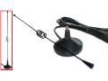
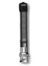
VHF/UHF Antennas (cont)
Magnetic mount mobile antenna
Operating in someone else's vehicle
Can also be used indoors
Sticking them to any steel surface, such as filing cabinets, beams, or ductwork, even up-side down
Rubber duckies
Negative gain
Use at least a ¼ wave flexible antenna
Telescoping 5/8 wave antenna for long-range use

Slide 18
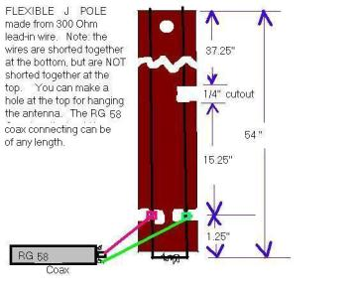
VHF/UHF Antennas (cont)
“Roll-up J-pole" antennas
Made from 300 ohm television twin-lead wire
Can be tacked up on a wall or hoisted into a tree with heavy-duty string

Slide 19
HF Antennas
No single perfect antenna for HF operation
Depends on:
Size and terrain of the area you need to cover
Conditions under which you must install/use it
“Near Vertical Incidence Skywave" (NVIS)
For local operations up to a few hundred miles
Random wire or dipole hung at a less than ¼ wavelength above the ground
Signal is reflected almost straight up, bounces off the ionosphere directly back downward
Best on 40 meters during the day, switching to 80 meters around sunset

Slide 20
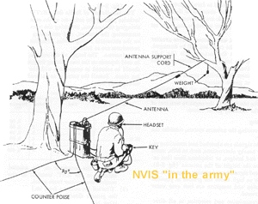
NVIS

Slide 21
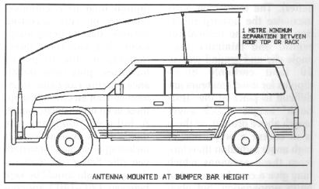
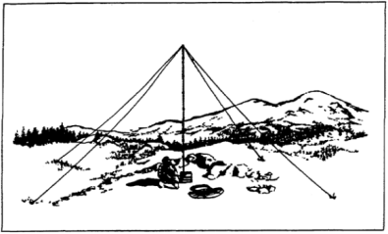
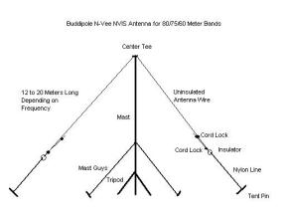
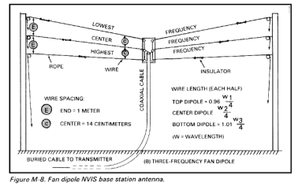
NVIS (cont)

Slide 22
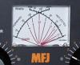
HF Antennas
Antenna tuner is necessary for most portable wire antennas
Especially for NVIS antennas
Antenna's impedance varies with height above ground and proximity to nearby objects
Can be a real problem with expedient installations
Include a ground rod, clamps and cable in your kit since almost all radios and tuners require a proper ground in order to work efficiently

Slide 23
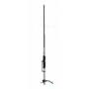
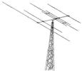
HF Antennas (cont)
Communication beyond 200 miles
Commercial trapped vertical may work
No ability to reject interfering signals from other directions
Directional (beam) antennas
Best performance for very wide area nets on 10 to 20 meters
Maximize desired signals and reduce interference from stations in other directions
Expensive, large, and difficult to store and transport

Slide 24

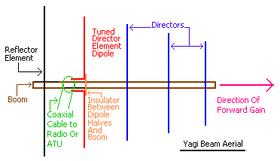
HF Beam Antenna

Slide 25
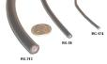
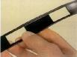
Feedline
VHF and UHF
Low-loss foam dielectric coaxial cable
RG-8X or RG-213
HF
Coaxial cable
Commercial insulated "ladder" line
Notes:
RG-8X is an "in-between" size that offers less loss and greater power handling capability than RG-58 with far less bulk than RG-213. If you with to carry only one type of cable, RG-8X is the best choice.
Ladder line offers somewhat lower loss but more care must be taken in it's routing, especially in proximity to metal objects, or where people might touch it. Coaxial cable is much less susceptible to problems induced by routing near metal objects or other cables.

Slide 26
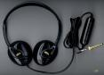
Operating Accessories
Headphones
EOC where multiple radios are in use must use headsets
VOX (voice operated transmit) capability
Should always be turned off and manual "push-to-talk" buttons used
Desk or boom microphone and foot switch to key the transmitter
Notes:
Accidental transmissions caused by background noise and conversations can interrupt critical communications on the net.

Slide 27
Batteries
Battery power is critical
Match the maximum load of the equipment, and the length of time that operation must continue before they can be recharged
Handheld transceivers
NiMH batteries
Store somewhat more energy than NiCd batteries for their size
Lithium Ion (LIon) batteries
Much higher power densities, without the so-called "memory effect" of NiCds
Notes:
AC power cannot usually be relied upon for any purpose, and portable operation for extended periods is common.

Slide 28
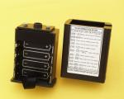
Batteries (cont)
Optional AA alkaline battery cases
Recommended emcomm accessory
Common alkaline batteries
Somewhat higher power density than NiCd batteries
Readily available in most store
May be all you have if you cannot recharge your other batteries.
External 13.8VDC power connection
Cigarette lighter or external battery use

Slide 29
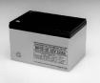
Batteries (cont)
External batteries
Any type can be used with a handheld
12-15 volt gel cells
Some battery packs intended for power tools and camcorders
Build a DC power cable for each of your radios, with suitable adapters for each battery type you might use

Slide 30
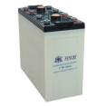
Lead Acid Batteries
Flooded (wet)
Can spill if tipped
SLA (Sealed Lead-Acid)
Can be operated in any position -- even up-side down
The optimum charging voltage for 12-volt lead acid batteries should be about two volts more than the battery's rated voltage.

Slide 31
"Deep-cycle" Batteries
Better choice than common automotive (cranking) batteries
Not designed to provide consistent power for prolonged periods
Best choice
Specified for UPS (uninterruptible power source) or recreational vehicle (RV) use

Slide 32
Sealed Lead Acid (SLA)
Available in smaller sizes that are somewhat lighter
Typical small sizes are 2, 4, and 7Ah, but many sizes of up to more than 100Ah are available
Should never be deeply discharged
A 12 volt SLA battery will be damaged if allowed to drop below 10.5 volts
Excessive heat or cold can damage SLA batteries
Storage temperatures between 40 and 60 degrees will provide maximum battery life

Slide 33
Battery "Power Budgeting”
Busy net control station = transmit current will be the determining factor because of the high duty cycle
Low activity stations = receiver current will dominate

Slide 34
Chargers, Generators and Solar Power
NiCd and NiMH batteries
Type of charger required depends on the battery
“Universal" chargers
Rapid-rate charger
Rapid charging can shorten a battery's overall lifespan
Lead-acid batteries
Always consult the battery's manufacturer for precise charging and maintenance instructions
Best to slow-charge all batteries
Automotive and deep cycle batteries can be charged with an automobile and jumper cables, an automotive battery charger, or any constant-voltage source

Slide 35
Chargers, Generators and Solar Power
SLA or "gel- cell"
Must be charged slowly and carefully to avoid damage
Charging voltage must be kept between 13.8 and 14.5 volts
Keep the charging current level to no more than 1/3 its rated capacity
Time it takes for a SLA battery to recharge completely will depend on the amount of charge remaining in the battery

Slide 36
Generators
Required at command posts and shelters
Lighting, food preparation, and other equipment
Radio equipment can be operated from the same or a separate generator,
But be sure that co-located multiple generators are bonded with a common ground system for safety
Not all generators have adequate voltage regulation
A voltmeter should be part of your equipment

Slide 37
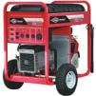
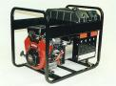
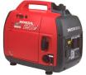
Generators (cont)

Slide 38
Generators (cont)
Noise levels can be a concern
Placing the generator at a greater distance and using heavier power cables to compensate.
Can also prevent fumes from entering the building and causing carbon monoxide poisoning
High quality surge suppressors, line voltage regulators, and power conditioners may help protect your equipment from defective generators
Variable voltage transformers ("Variacs" ™) can be useful to compensate for varying power conditions

Slide 39
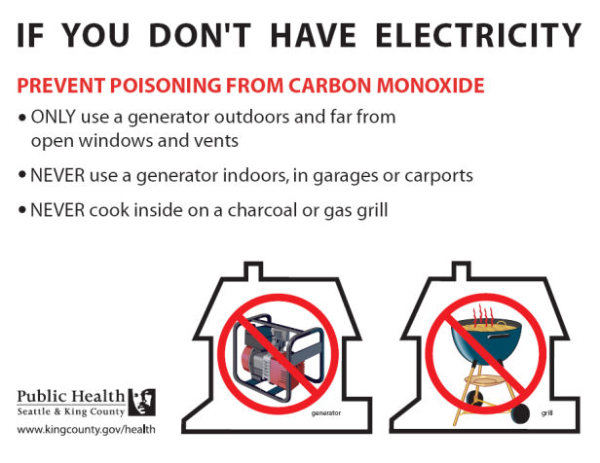
Generator Safety

Slide 40
Power Connectors and Cables
12 amp Molex 1545 series connector
In the past ARRL publications recommended
Adequate for low power mobile radios, hand-helds, and accessories
Can overheat and fail when used with high power equipment and heavy duty cycles
30 amp Anderson Powerpole connector
Most groups now use
Handle much greater current
Capable of being plugged and unplugged many hundreds of times (operations) without deterioration

Slide 41
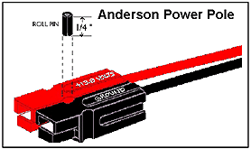
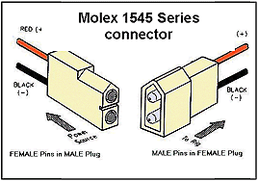
Power Connectors and Cables

Slide 42
Power Connectors and Cables (cont)
All power cables should be properly fused in both the positive and negative leads
Fusing the negative leads helps to protect equipment from ground-fault currents
Vehicle "cigarette lighter plug" or "power point"
May not able to deliver adequate current for mobile FM or HF radios operating at high power
Direct connection to the vehicle battery
Know how much current your radio draws at different output power settings

Slide 43
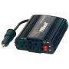
DC to AC Inverters
Not all inverters are suitable for use with radios, computers, or certain types of battery chargers
Best inverters are those with a "true sine-wave"
"modified sine-wave" output may not operate certain small battery chargers, and other waveform-sensitive equipment
"high-frequency conversion" inverters generate significant RF noise if they are not filtered
Alternative to an inverter
Mid-sized 12V computer UPS (uniterruptible power source)
Smaller, square-wave UPS units are not designed for continuous duty applications
Larger true sine-wave units are designed for continuous duty
Notes:
Smaller, square-wave UPS units are not designed for continuous duty applications, but larger true sine-wave units are. Most true sine-wave units use internal batteries, but with minor modifications can be used with external batteries. The larger commercial UPS units run on 24 or 48 volts, and require two or four external batteries in series. UPS units will have a limit on the number of depleted batteries they can re-charge, but there is no limit to the number of batteries that can be attached to extend operating time.

Slide 44
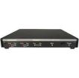
Equipment For Other Modes
Digital modes (packet, APRS, AMTOR, PSK31, etc)
Computer and a TNC or computer sound card interface
Software and cables
Internal battery in your laptop computer
External DC power supply and cable, or a DC to AC inverter
Printer

Slide 45
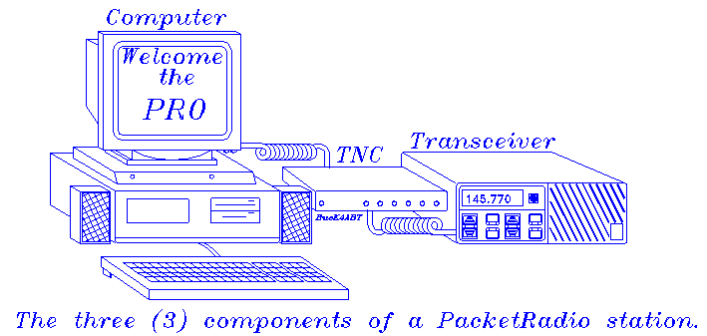
Packet

Slide 46
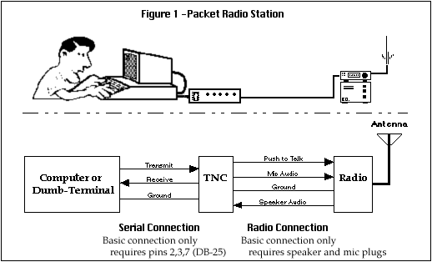
Packet Radio Station

Slide 47
Scanners and Other Useful Equipment
Multi-band scanning radio (to monitor public service and media channels)
FRS, GMRS or MURS hand-helds (more about these in LU 18)
Cellular telephone (even an unregistered phone can be used to call 911)
Portable digital recorder with VOX (for logging, recording important events)
AM/FM radio (to monitor media reports)
Portable television (to monitor media reports) once portable digital receivers are available
Weather Alert radio with "SAME" feature (to provide specific alerts without having to monitor the channel continuously)
Laptop computer with logging or emcomm-specific packet software
Sirius/XM Satellite Radio Receiver (Emergency Alert Channel)
Satellite television receiver (providers had “free” channel available during Katrina)

Slide 48
Testing The Complete Station
After making your equipment selection (or beforehand if possible), field test it under simulated disaster conditions
ARRL Field Day
Test all elements of your system together
From power sources to antennas
Try as many variations as possible

Slide 49
Summary
Any questions before the quiz?

Slide 50
Time for a Quiz
Take 30 Seconds adjust your workspace

Slide 51
30
Seconds

Slide 52
20
Seconds

Slide 53
10
Seconds

Slide 54
9
Seconds

Slide 55
8
Seconds

Slide 56
7
Seconds

Slide 57
6
Seconds

Slide 58
5
Seconds

Slide 59
4
Seconds

Slide 60
3
Seconds

Slide 61
2
Seconds

Slide 62
1
Seconds

Slide 63
Let's get started!

Slide 64
Topic 18 Question
In considering power sources for HF radios, which of the following is true?
DC to AC inverters can be used to power HF radios
Standard automotive batteries last longer than deep cycle batteries
AC powered HF radios are suitable for all emcomm use
Whenever possible, use deep cycle batteries to power HF radios

Slide 65
Topic 18 Question
In considering antennas for VHF/UHF radios, which is the best rule?
High transmitter power is more important than having a good antenna
Transmitter power and antenna selection are equally important
A good antenna is more important than high transmitter power
If properly used, "rubber ducky" antennas can compensate for low transmitter power

Slide 66
Topic 18 Question
Beam antennas have many advantages. Which of the following is the best reason for selecting a beam antenna?
They are inexpensive and easy to transport
They are easy to erect and very stable in storm conditions
They are compact and easy to store
They maximize desired signals and reduce interference from other stations

Slide 67
Topic 18 Question
Which of the following statements about ARES deployment clothing is true?
Three years (until 2013) are being given to “wear out” and replace older clothing
The standards increase recognition and acceptance of ARES units
The standards apply only to clothing worn on actual ARES deployments
All of the above

Slide 68
Topic 18 Question
In comparing the 30 amp Anderson power pole connector with the 10 amp Molex connector, which of the following statements is true?
The Molex is better for high power applications
The Molex is better for heavy duty cycles
The Anderson handles only low power applications
The Anderson is capable of being plugged and unplugged a greater number of times without deterioration

Slide 69
B r e a k
10 Minutes

Slide 70
10
Minutes

Slide 71
5
Minutes

Slide 72
2
Minutes

Slide 73
1
Minute

Slide 74
50
Seconds

Slide 75
40
Seconds

Slide 76
30
Seconds

Slide 77
20
Seconds

Slide 78
10
Seconds

Slide 79
9
Seconds

Slide 80
8
Seconds

Slide 81
7
Seconds

Slide 82
6
Seconds

Slide 83
5
Seconds

Slide 84
4
Seconds

Slide 85
3
Seconds

Slide 86
2
Seconds

Slide 87
1
Seconds

Slide 88
Let's get started!

Slide 89
Any Questions Before Starting Topic 19?

